Slide 1
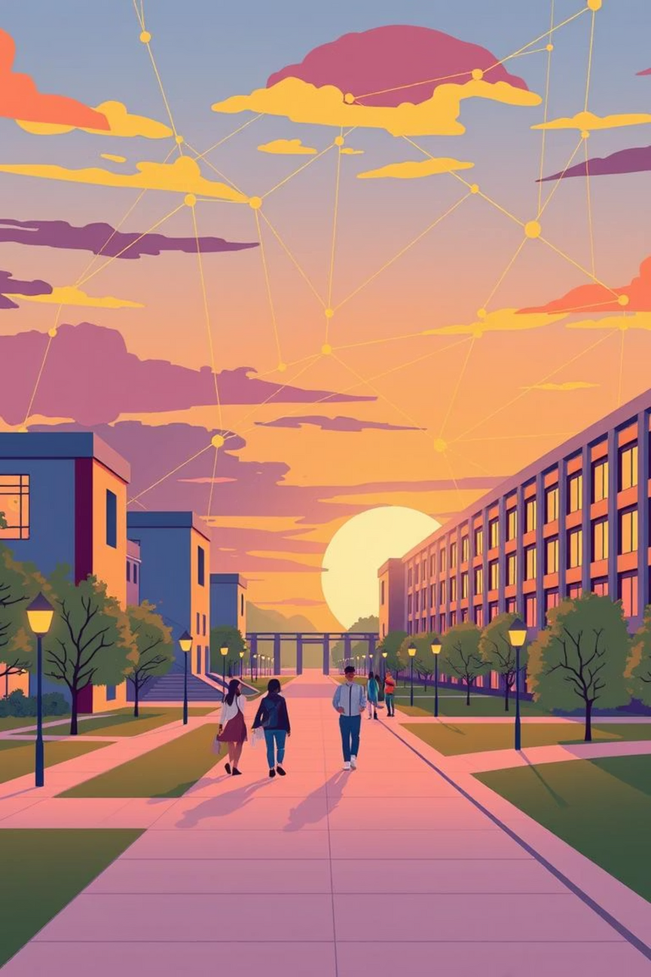
University Network Simulation
FACULTY OF ENGINEERING SCIENCES AND TECHNOLOGY
Submitted By: Avinash Talreja

Slide 2

Why Digital Campuses?
The world is shifting to a digital era, and educational institutions must adapt.
Crucial Digital Shift
Adapt & Evolve
Technology advances demand digital transformation.
Institutions must become "digital campuses."
Future-Proof Education
Embrace digital for modern learning environments.

Slide 3

Wireless: The Core of Modern Campuses
Wireless networking is essential for campus life, enhancing connectivity and access.
Reduced Cables
Simplifies infrastructure and device management.
Enhanced Connectivity
Access resources anytime, anywhere.
Mobility & Flexibility
Supports growing use of laptops and smart devices.
Modern Campus Mark
Efficient, cable-free internet access for teaching and research.

Slide 4
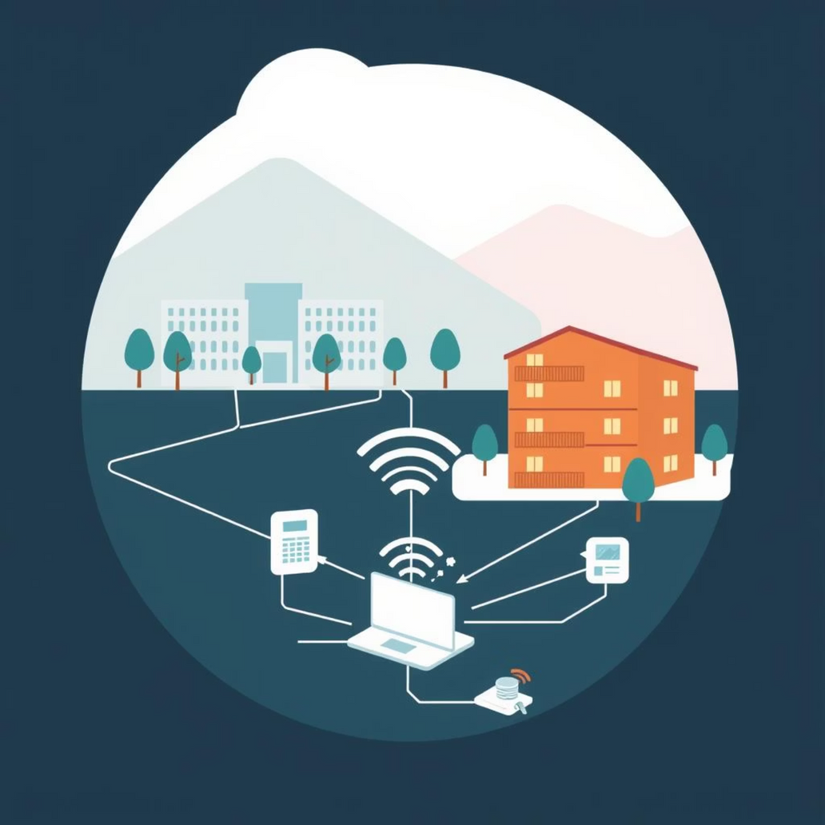
Project Concept: Campus Network Simulation
This mini-project simulates a university network based on wireless connectivity.
Network Division
Campus Area
Hostel Area
Ensuring tailored connectivity for distinct zones.
Focus on efficient and mobile network solutions.

Slide 5

Core Objectives & Services
Our project aims for efficient, mobile, and fully functional wireless connectivity.
Wireless Mobility
Equal Functionality
Major concentration: seamless movement across campus.
DNS, Email, HTTP servers for all users.
Comprehensive Services
Internet access, data sharing, web services.

Slide 6
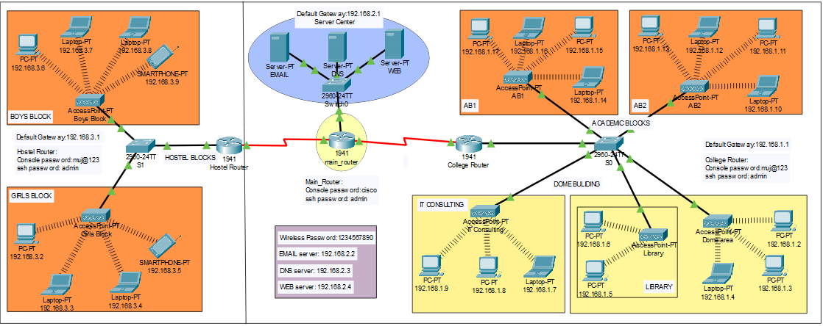
Network Design Overview
Visualizing the simulated campus network topology.
A detailed representation of the interconnected campus and hostel areas.

Slide 7
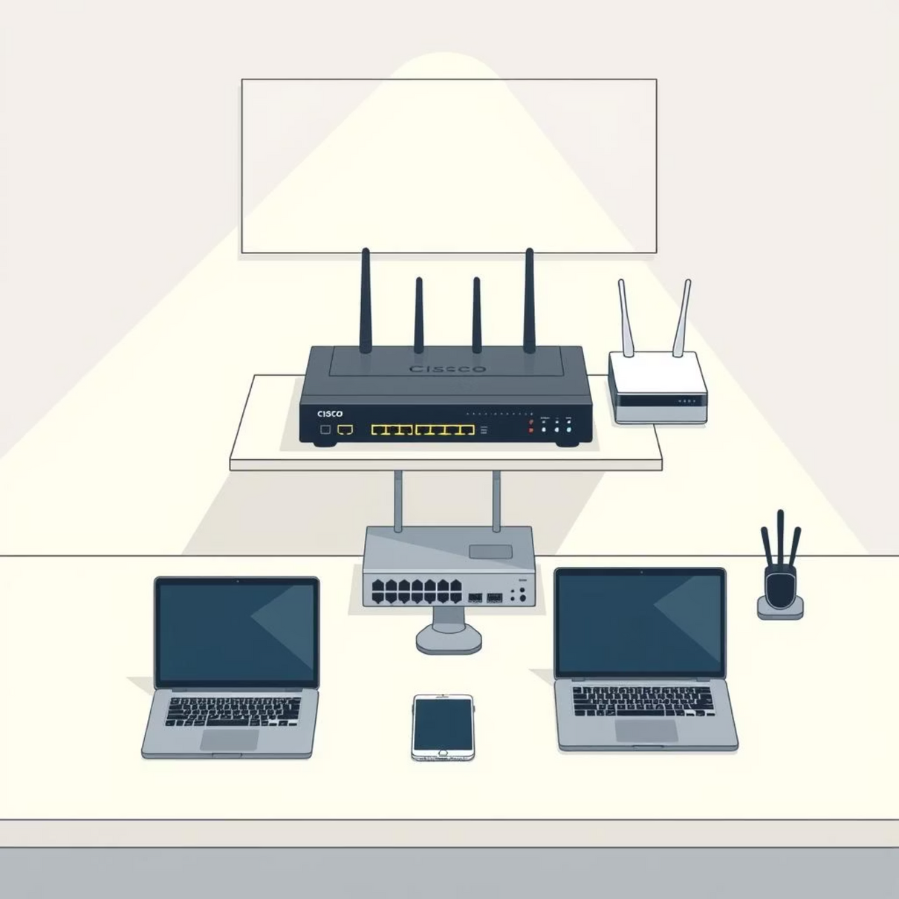
Key Components & Areas
Hardware & Devices
Router (Cisco 1941)
Switches (Cisco 2960-24TT)
Servers: Email, DNS, Web
Wireless Access Points
Computing devices: PCs, Laptops, Smartphones
Network Zones
Campus: Academic Blocks, Dome, Library, IT Consulting
Hostel: Boys & Girls Blocks

Slide 8
Methodology: Building the Network
Our structured approach to designing and implementing the wireless network.
1
2
3
Topology Design
IP Addressing
Security Implementation
Routers, switches, servers, wireless devices.
Carefully planned scheme for efficient traffic.
SSH and strong passwords for protection.
4
5
Wireless Configuration
Network Testing
Secure SSIDs with robust passwords.
Packet Tracer simulation and ping tests.

Slide 9
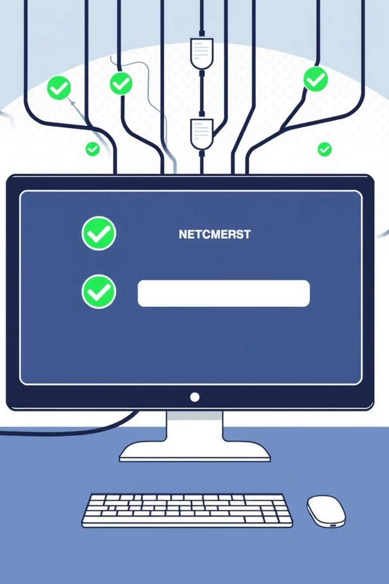
Analysis & Results: A Functional Network
The simulation successfully demonstrated a robust and secure wireless campus network.
Functional Connectivity
Across academic blocks, library, dome, hostels, IT consulting.
Seamless Mobility
Users accessed services without physical cables.
Reliable Services
DNS, Web, Email servers responded effectively.
Enhanced Security
Protected routers and wireless access points.

Slide 10

Conclusion & Future Vision
This project serves as a foundational prototype for digital campus networking.
Project Success
Key Advantages
Future Work
Demonstrated wireless network design and implementation.
Enhanced mobility, easier management, scalable access.
Higher bandwidth, enhanced security, expanded outdoor coverage.

